Slide 1
analysis of movies
Module 1 Project
By
Ezgi Gumusbas
Srikanth Gungi

Slide 2
Goal of The Project
To help Microsoft Company in building a competitive movie studio by giving insights about the movies.
Giving information about best box office movies.
Shortlisting best genres
Choosing a good month for a movie release.

Slide 3
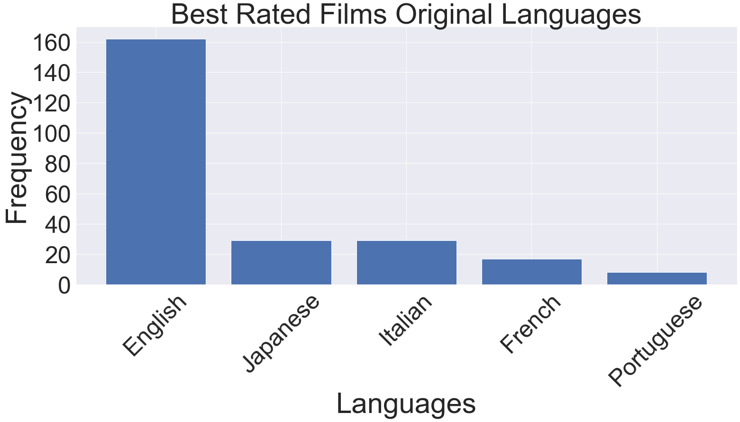
Best Rated-Original Language Movies

Slide 4
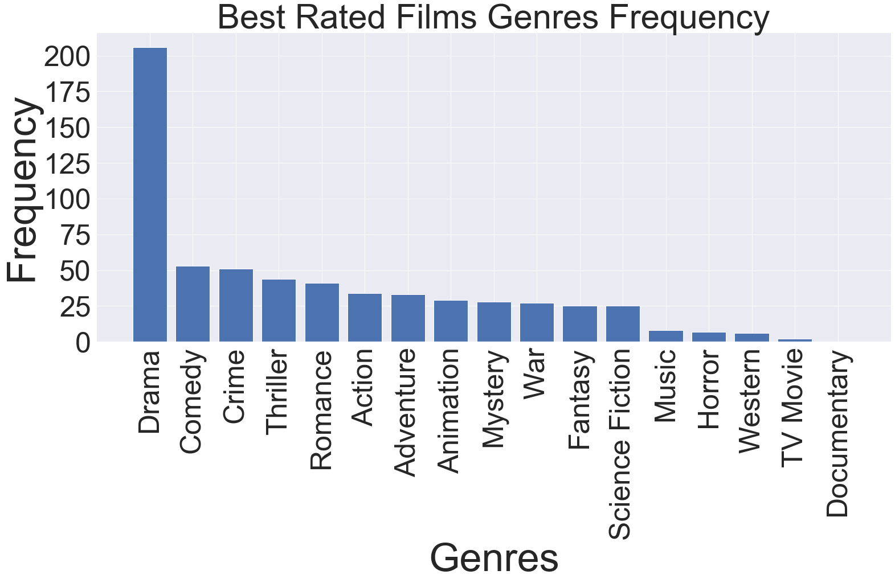
Best Rated Genres(above 8 rating)

Slide 5
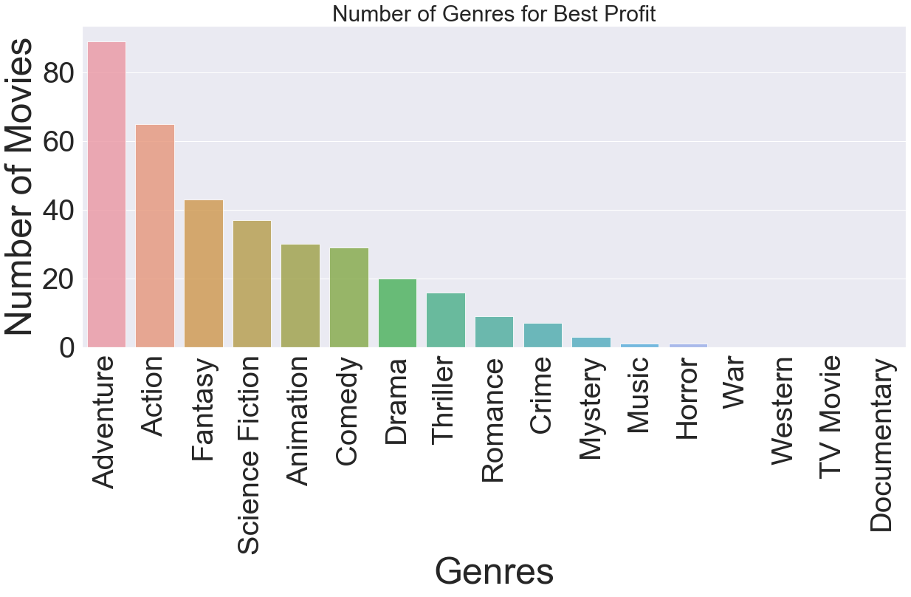
Genres With Best Profits(above $500 M)

Slide 6
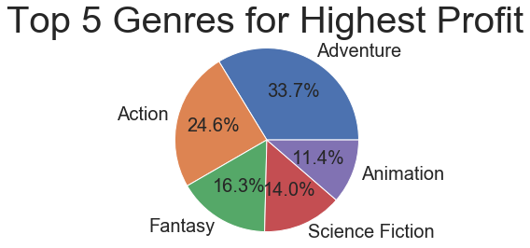
Genres With High Profits

Slide 7
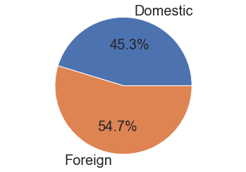
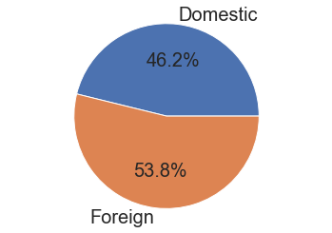
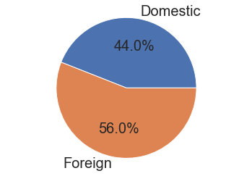
Domestic Gross Vs Foreign Gross Based On Top Rated Genres
Drama
Crime
Comedy

Slide 8
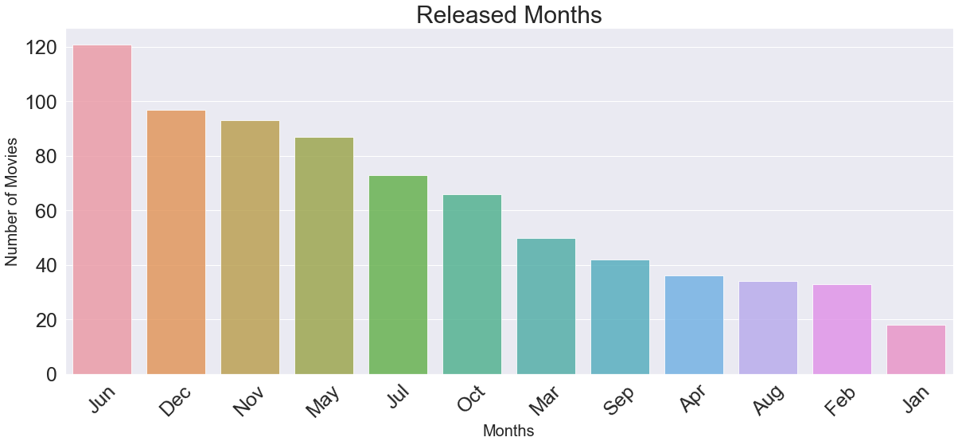
Movie Releases Across The Calendar

Slide 9
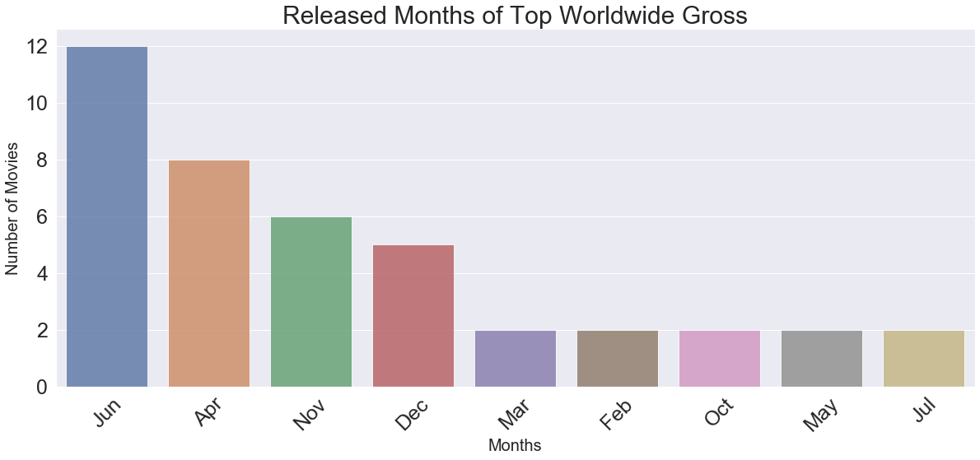
Top Grosser Movies Released Across The Calendar(above $1 B)

Slide 10
Further Developments
Getting data of movies with best screenplays.
Analyzing the data with best directors to shortlist the best directors to work.
Shortlisting the best story writers and books that has blockbusters.
Getting best production houses to cosponsor the movies.

Slide 11
Thank you Any questions?

